Slide 1



SYNOPSIS PRESENTATION (ECO342A)
INDIAN INSTITUTE OF TECHNOLOGY KANPUR
SUBMITTED BY - DEBASHREE PRIYA SAHOO(200307)
SUBMITTED TO - PROF. SOMESH KUMAR MATHUR

Slide 2
TOPIC
Income Inequality and Crime: Dynamic Impacts Using Panel Data in India

Slide 3
CONTENTS
INTRODUCTION
PURPOSE
LITERATURE REVIEW
RESEARCH GAP
DIFFERENT ESTIMATION METHODS AND ABOUT THE MODEL
HYPOTHESIS
METHODOLOGY
OBJECTIVE AND SIGNIFICANCE
EXPECTED RESULTS OR CONCLUSIONS

Slide 4
INTRODUCTION
Income inequality and crime rate have been two topics of great interest for researchers, policymakers, and the general public.
the connection between income inequality and crime is complex and multifaceted, and there is much debate among scholars about the nature and extent of this connection and it may depend on various factors such as social norms, economic conditions, and institutional factors.
This research paper seeks to explore the dynamic effects of income inequality on crime, using a comprehensive theoretical framework and empirical analysis of data from a range of sources.
Through this base paper, I aim to analyse the effect of income inequality on crime across different Indian states through panel data analysis and will also apply different nonparametric analysis methods

Slide 5
PURPOSE
Through this base paper, I aim to analyse the effect of income inequality on crime across different Indian states through panel data analysis and will also apply different nonparametric analysis methods and try to address the endogeneity issues through fixed effects(unobserved heterogeneity constant over time) or first difference model(unobserved heterogeneity changes over time).
The purpose of this research analysis is to provide a comprehensive overview of the existing research on income inequality and crime rate and to identify gaps in the literature. We will also discuss the policy implications of the findings and suggest directions for future research.

Slide 6
LITERATURE REVIEW
The relationship between income inequality and crime has been extensively studied in the academic literature, with mixed results. Some studies have found a positive and significant relationship between income inequality and crime rates, while others have found no relationship or even a negative relationship.
Some of them are as follows
Fajnzylber et al. (2002) found a positive and significant relationship between income inequality and violent crime in a panel of countries.
Demombynes and Ozler (2005) also found that inequality is associated with property and violent crimes in South African neighborhoods.
Enamorado et al. (2016) found that a one-point increase in the Gini coefficient raises drug-related homicides.
Brush (2007)- mixed evidence- Inequality has a positive link with crime in a cross-section of U.S. counties but a negative association in time-series analysis.
Doyle et al. (1999) and Neumayer (2005) - no significant link between inequality and violent crime

Slide 7
A major endogeneity issue caused by measurement error, unobserved heterogeneity, and the simultaneous determination of crime and income inequality underlies these contradictory empirical results.
The contradictory empirical results on the relationship between income inequality and crime may be due to a problem of causality.
Hard to isolate the effect of inequality on crime for example use of education policies to reduce crime rates can also help reduce income inequality.
The base paper estimated a panel SVAR model to assess the relationships among multiple variables in a system and identify the relative importance of various shocks on the system for US state-level data set from 1960-2015
Different reference paper also shows institutions' qualities influence how closely economic inequality and crime are related

Slide 8
RESEARCH GAP
Problem of simultaneity bias in regression of crime on income inequality- the two variables are related here.
Omitted variables and measurement errors can lead to biased estimates.
Inadequate attention to mediating factors- such as poverty, education, employment opportunities etc.
Limited attention to policy implications
Inadequate consideration for reverse causality

Slide 9
DIFFERENT ESTIMATION METHODS AND ABOUT THE MODEL
Panel data used to address unobserved heterogeneity- helps researchers control for individual-level characteristics that may be correlated with both crime and income inequality, thus reducing unobserved heterogeneity.
Fixed effects models-a type of regression analysis that controls for individual-specific unobserved heterogeneity that does not vary over time. By including individual fixed effects, researchers can identify within-individual changes in the outcome variable (crime) that are associated with changes in the independent variable (income inequality).
instrumental variable (IV)- used to estimate causal effects when the relationship between the independent variable (income inequality) and the outcome variable (crime) is potentially confounded by unobserved variables. One type of IV method is differences-in-differences (DID), which exploits exogenous sources of variation in income inequality (e.g., changes in tax policy) to estimate causal effects.

Slide 10
ABOUT THE MODEL
The equation being used is investigating the marginal effect of income inequality on crime rate while taking institutional quality as an interactive term.
This is being done using a panel data regression framework, which allows for controlling for individual-level characteristics that may be correlated with both crime and income inequality.
The model includes several control variables, such as lagged dependent variable, real GDP per capita, unemployment rate, urbanization, inflation, and tertiary education.
The interaction term between institutions and crime rate is also included as a control variable, and a new interaction term between institutions and income inequality is added to investigate the marginal effect of income inequality on crime rate.
The significance of the signs of the slope parameters is discussed, with some expected to be positive (such as income inequality and unemployment) and some expected to be negative (such as institutional quality and average income).
Finally, a reduced-form panel VAR model is used to estimate the causal effects of income inequality on crime rate, using the GMM estimator suggested by Arellano and Bover (1995).

Slide 11
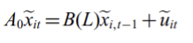
𝐶𝑀𝑅𝑖𝑡 = 𝛼0 + 𝛽1𝐶𝑀𝑅𝑖𝑡−1 + 𝛽2𝐼𝐸𝑖𝑡 + 𝛽3𝐼𝑁𝑆𝑇𝑖𝑡 + 𝛽4𝑅𝐺𝐷𝑃𝐶𝑖𝑡 + 𝛽5𝑈𝑒𝑚𝑖𝑡 + 𝛽6𝑈𝑏𝑖𝑡 + 𝛽7𝐼𝑁𝐹𝑖𝑡 + 𝛽8𝐸𝑑𝑢𝑖𝑡 + 𝜇𝑖+ 𝜀𝑖t
Interactive equation- 𝐶𝑀𝑅𝑖𝑡 = 𝛼0 + 𝛽1𝐶𝑀𝑅𝑖𝑡−1 + 𝛽2𝐼𝐸𝑖𝑡 + 𝛽3𝐼𝑁𝑆𝑇𝑖𝑡 + 𝛽4 (𝐼𝐸𝑖𝑡 × 𝐼𝑁𝑆𝑇𝑖𝑡) + 𝛽5𝑅𝐺𝐷𝑃𝐶𝑖𝑡 + 𝛽6𝑈𝑒𝑚𝑖𝑡 + 𝛽7𝑈𝑏𝑖𝑡 + 𝛽8𝐼𝑁𝐹𝑖𝑡 + 𝛽9𝐸𝑑𝑢𝑖𝑡 + 𝜇𝑖+ 𝜀𝑖t
Significance of signs
β2- expected to be +ve signifies higher income inequality, higher violent crime
β3-expected to be -ve- better the institutional quality better the crime rate
𝛽4- can be both +ve/-ve(buffer)
β5- expected to be -ve- avg income increases crime rate decreases
β6, β7, and β8- expected to be of +ve sign- increase in unemployment, inflation rate and inflation increases the crime rate
𝛽9- expected to be +ve- higher level of education lower the crime rate
And
A reduced-form panel VAR model
implemented using the GMM estimator suggested by Arellano and Bover (1995)
𝐼𝐸- income inequality (Gini coefficient)
𝐶𝑀𝑅𝑖𝑡−1 - lagged dependent variable
𝐶𝑀𝑅- Crime rate
RGDPC- real gross domestic product per capita
Uem- the unemployment rate
Ub-Urbanization
Edu- tertiary education
INF- inflation
𝜀-error term
INST- the interaction of institutions with crime rate(control variable)
𝐼𝐸 × 𝐼𝑁𝑆𝑇- interaction term of an institution with income inequality on crime rate
i-country and t-year
𝛽1, 𝛽2, 𝛽3, 𝛽4, 𝛽5, 𝛽6, 𝛽7are the slope parameters to be estimated

Slide 12
BASE MODEL
𝐶𝑀𝑅𝑖𝑡 = 𝛼0 + 𝛽1𝐶𝑀𝑅𝑖𝑡−1 +𝛽2𝐸𝑖𝑡 + 𝛽3𝑃𝑜𝑝𝑢𝑙𝑎𝑡𝑖𝑜𝑛_𝑑𝑒𝑛𝑠𝑖𝑡𝑦it + 𝛽4𝑈𝑒𝑚𝑖𝑡 + 𝛽5𝐼𝑁𝐹𝑖𝑡 + +𝛽6gr𝑖𝑡 + 𝛽7edu𝑖𝑡 + 𝛽8𝐺S𝐷𝑃𝐶𝑖𝑡+ 𝜀𝑖t
𝐶𝑀𝑅𝑖𝑡- Crime rate in state i at time t
𝐶𝑀𝑅𝑖𝑡−1-Crime rate in state i at time t-1 (lagged dependent variable)
𝐼𝐸𝑖𝑡- Income inequality (SPI Index) in state i at time t
𝐺S𝐷𝑃𝐶𝑖𝑡- Gross State Domestic Product in state i at time t
𝑈𝑒𝑚𝑖𝑡- The unemployment rate in state i at time t
I𝑁𝐹𝑖𝑡- Inflation rate for region i at time t
𝑃𝑜𝑝𝑢𝑙𝑎𝑡𝑖𝑜𝑛_𝑑𝑒𝑛𝑠𝑖𝑡𝑦it- Population density for region i at time t
edu𝑖𝑡- Education level (net enrollment rate in primary education) in state i at time t
gr𝑖𝑡- Demographic factors (gender ratio) in state i at time t
𝜀𝑖t- Error term

Slide 13
HYPOTHESIS
Higher income inequality causes higher crime rates in India. Non-parametric methods such as difference-in-differences estimation and panel data analysis will be used which can help identify the causal effect of income inequality on crime rates.
Institutional quality moderates the relationship between income inequality and crime in India. This hypothesis aims to investigate whether India's institutions have an impact on the relationship between income disparity and crime.
The study will examine the influence of income inequality on property and violent crimes in India and analyze which has a stronger impact. Compare GINI index with different crime measures.
The study will also analyze different policies aimed at reducing poverty, improving education, and creating employment opportunities to determine their impact on income inequality and crime rates across different states.

Slide 14
METHODOLOGY
I will be using panel data analysis using a panel VAR model to examine the dynamic relationship between income inequality and crime rates in multiple Indian states over time, while controlling for other relevant factors. To address potential endogeneity or reverse causality issues in the model, I would try to use GMM estimation or first difference model(unobserved heterogeneity changes over time).
Threshold regression to gain insights into the relationship between income inequality and crime in India without making assumptions on the relationship's functional structure.
OLS and 2SLS regression
Unit Roots test for stationarity check and ARDL approach

Slide 15
GMM ESTIMATION
GMM provides reliable estimates compared to OLS and fixed-effects estimations.
GMM resolves endogeneity issues by incorporating lagged values for the dependent variable, which helps in internally transforming the data.
The three main endogeneity sources—unobserved heterogeneity, simultaneity, and dynamic endogeneity—can be controlled for using the GMM model.
Instruments in GMM should be chosen such that they are correlated with the endogenous regressors but not correlated or orthogonal to the errors.
In GMM, one minimizes e’ZWZ’e, where W is the weighting matrix and Z is a matrix of instruments.
The moment or orthogonality condition is E(Z’u)=0, which ensures that the instruments are exogenous and can be used to identify the causal effects of income inequality on crime rates.

Slide 16
GMM ESTIMATION EQUATION
Using the Arellano-Bover GMM estimator, the general model form to be used is
Crimei,t = α0+ α1Crimei,t-1 + α2Income_Inequalityi,t + β1 controli,t + β2 instrumentsi,t + εi,t
Crime,t- the crime rate for individual i for time period t
Crimei,t-1- One period lagged operator(previous year crime rate)
Income_Inequalityi,t - the income inequality measure for individual i for time period t
α1 and α2 - Parameters
Controli,t- vector of control variables that may affect crime rates, such as demographics, economic conditions, and social factors.
β - vector of parameters to be estimated for the control variables.
εi,t-error term that captures unobserved factors affecting crime rates.
The three main endogeneity sources—unobserved heterogeneity, simultaneity, and dynamic endogeneity—can be controlled for using the GMM model.

Slide 17
INSTRUMENTAL VARIABLE REGRESSION (RE, FE, BE, FD)-
IV regression estimates causal relationships in the presence of endogeneity, addressing bias in OLS estimates.
Useful for random effects, fixed effects, between effects, and first difference panel data models.
Instrumental variables are used to obtain consistent estimates of parameters of interest.
Helps overcome endogeneity issues and provides reliable estimates of causal effects.
IV regression is a valuable tool for panel data analysis, enhancing the validity of causal inferences.

Slide 18
THRESHOLD REGRESSION
Threshold regression with dynamic panel data models relationships with changing coefficients based on threshold variables in panel data.
Dynamic panel data includes lagged values, capturing time dynamics and potential endogeneity issues.
This approach allows for estimation of separate coefficients for different regimes or states of the threshold variable.
It can uncover complex relationships not captured by linear regression methods.
Valuable tool for analyzing panel data with non-linearities and time dynamics.

Slide 19
PANEL UNIT ROOT TESTS
Panel unit root tests are statistical tests used to determine if a panel data series exhibits unit root behavior, indicating non-stationarity and a stochastic trend.
Panel unit root tests are useful in panel data analysis to assess the stationarity of variables, which is important for econometric modeling.
If a variable is found to have a unit root, it suggests that the variable is non-stationary and may require differencing or other techniques for stationarization.
Panel unit root tests help in identifying the appropriate treatment of non-stationary variables in panel data analysis, aiding in robust and reliable econometric modeling.
Commonly used panel unit root tests include the Levin-Lin-Chu (LLC) test, the Im-Pesaran-Shin (IPS) test, and Fisher-type panel unit root tests.

Slide 20
ARDL APPROACH TO COINTEGRATION AND BOUNDS TEST
ARDL approach to cointegration is used when panel unit root tests indicate that variables in a panel dataset are non-stationary and exhibit unit root behavior.
ARDL involves estimating an autoregressive model that includes lagged levels and first-difference terms of non-stationary variables, along with other relevant variables.
The lag order in the ARDL model is determined based on standard model selection criteria, such as AIC or BIC.
ARDL allows for the estimation of short-run and long-run dynamics between the variables, even when not all variables are stationary, making it advantageous for panel data analysis.
Bounds test can be used to confirm the existence of cointegration, and the estimated coefficients in the ARDL model can be interpreted as the long-run equilibrium relationship between the variables.

Slide 21
WHAT INSTRUMENTS AND CONTROL VARIABLES I HAVE CHOOSEN
DEPENDENT VARIABLE- IPC+SLL CRIMES
IPC crimes- Indian Penal code of india, includestheft, robbery, cheating, murder, kidnapping, and rape, among others.
SLL crimes- Special and Local Laws, which refers to the various special laws enacted by the Indian government to address specific types of offenses or situations. EX-Crimes under Special Laws: under the NDPS act, cyber crimes, some crimes against women
The total IPC and SLL crimes reported can provide a broad understanding of the overall crime situation in India
INDEPENDENT VARIABLE- SPI INDEX
The Social Progress Index (SPI) is a composite index that measures the social and environmental well-being of countries. One of the indicators included in the SPI is the Gini coefficient, which is a measure of income inequality. The Gini coefficient ranges from 0 (perfect equality) to 1 (perfect inequality), with higher values indicating greater income inequality.

Slide 22
INSTRUMENTS- GSDP,EDUCATION
Gross State Domestic Product (GSDP in lakhs) is a measure of the total economic output of a state in India. it is often used as an indicator of economic development and growth, and higher levels of GSDP are generally associated with higher levels of economic prosperity and higher standards of living for residents of a state and higher levels of GSDP may be associated with greater access to education and job opportunities, which can reduce income inequality.can lead to higher levels of income for some individuals. However, if the benefits of economic growth are not distributed equally across the population, this can contribute to income inequality. GSDP is not a direct measure of income inequality, it can be a useful indicator of the underlying economic and social conditions that contribute to income inequality.
Education(net enrollment rate) in primary education-Net enrollment rate (NER) in primary education can be a useful indicator for educational attainment. NER is the percentage of primary-school-age children who are enrolled in primary school. Overall, income inequality can indirectly affect NER in several ways, by creating disparities in access to educational resources, affecting the quality of education, and limiting the ability of low-income families to pay for education.

Slide 23
CONTROL VARIABLES- POPULATION DENSITY,UNEMPLOYMENT RATE, INFLATION RATE, GENDER RATIO
control variables are factors that are held constant or kept consistent in order to isolate the effects of the independent variable on the dependent, can more accurately assess the impact of income inequality on crime rates without the influence of other factors that might be related to both income inequality and crime rates.
Gender ratio per thousand is a measure used to express the number of females per thousand males in a given population. Gender ratio can also play a role in crime rates, as research has shown that there is a correlation between gender imbalance and higher crime rates
The CPI(Consumer Price Index) is used as a key indicator of inflation, which is the rate at which the general level of prices for goods and services is rising. Inflation rate CPI can also influence crime rates, as it reflects the overall economic conditions in a given area. High levels of inflation can lead to higher levels of poverty and economic instability, which can increase the likelihood of criminal activity
Unemployment rate is a measure of the percentage of the labor force that is not currently employed but is actively seeking employment and is available to work. High levels of unemployment may lead to higher crime rates as individuals may turn to illegal activities to make ends meet.

Slide 24
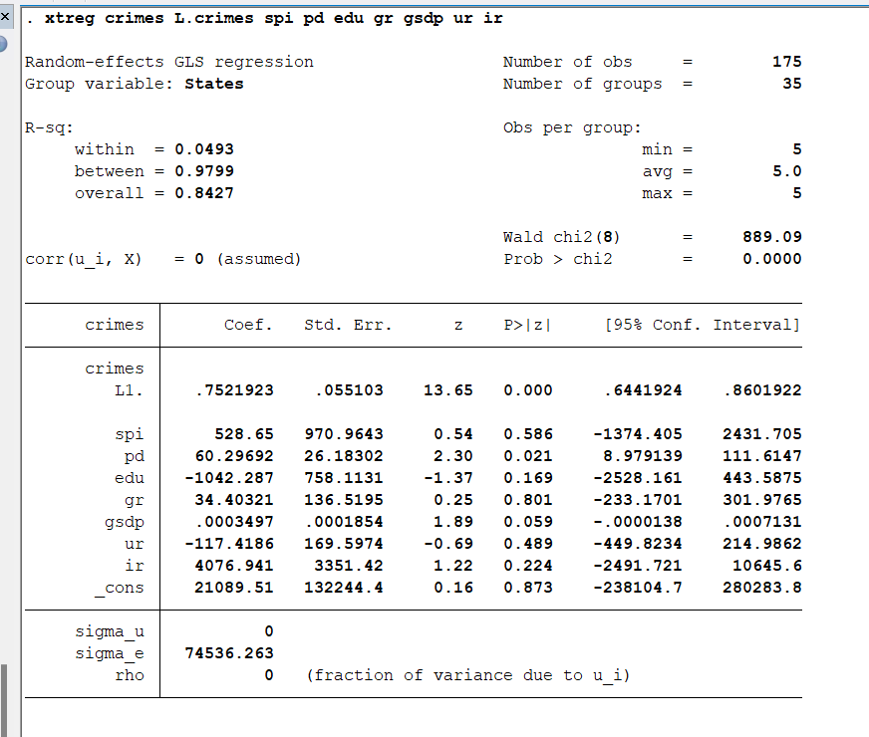
OLS
I have used SPI index as a proxy or indicator for income inequality here
My expected result is that there should be a +ve relation between income inequality and crime rate and I am getting a positive and significant value for SPI here.
SPI index is significantly correlated with crimes and has positive correlation
So normal OLS is trying to give the required results.
What is SPI index?
SPI- social progress index is an indirect indicator for income inequality. Some of the dimensions and indicators included in the SPI, such as access to basic education, health, and infrastructure, may be related to income inequality. For example, if a particular state or country has a low SPI score, it may suggest that the population is experiencing high levels of deprivation in various areas, which may be related to income inequality. It is possible that other factors, beyond income inequality, may be driving the positive correlation between the SPI index and crime rates. For example, higher levels of social well-being may be associated with increased urbanization, which can in turn lead to higher levels of property and violent crime. Additionally, some studies have found that higher levels of social well-being can lead to increased reporting of crimes, which may inflate crime rates.
reg ipcsllcrimes spiindex unemploymentrateinthousands infaltionratecpipercent populationdensitylakhs genderratioperthousand

Slide 25
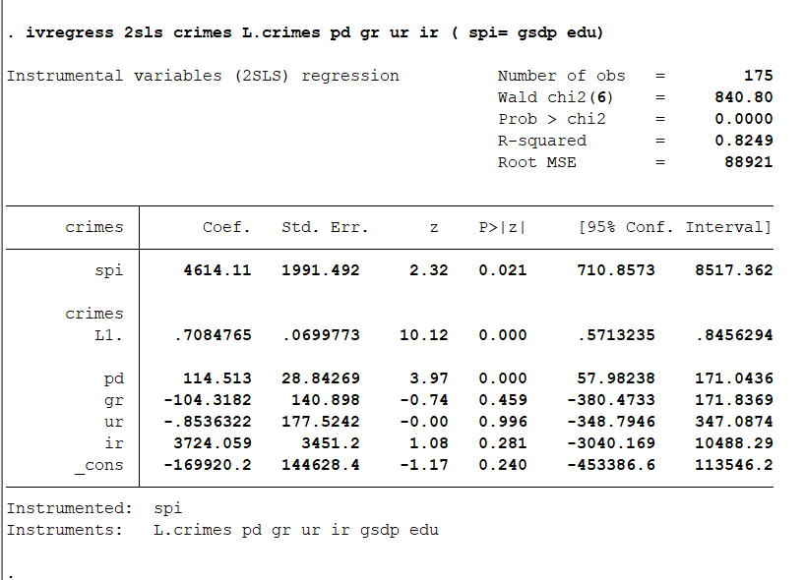
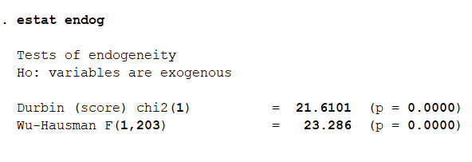
TESTS FOR ENDOGENEITY
(Checking if coefficients obtained from 2sls= that of ols)
We can see that the all the coefficients obtained from 2sls are different from that of ols so there is endogeneity
ivregress 2sls ipcsllcrimes populationdensitylakhs genderratioperthousand infaltionratecpipercent unemploymentrateinthousands ( spiindex= educationnetenrolllmentrate gsdpinlakhs )
We reject the null hypothesis here and find that the regressors are endogeneous as p value is significant and ols will give biased estimates. So we can move ahead and use GMM

Slide 26
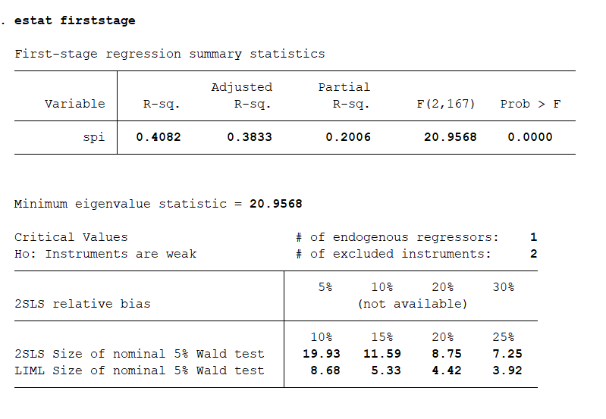
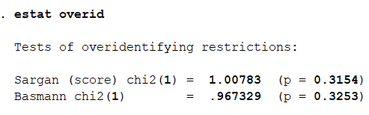
WEAK OR STRONG INSTRUMENTS?
The instruments are weak, shown by low value of R square and the minimum eigenvalue value is also not so high. Suggests that GMM is appropriate as weak instruments are there and I have more number of instruments than endogenous regressors.
Over identification test
In output, the p-values for both tests are greater than 0.05, which suggests that the null hypothesis of valid instruments cannot be rejected at conventional levels of significance. This indicates that the instruments used in the model are valid, and the 2SLS estimator is unbiased and consistent.

Slide 27
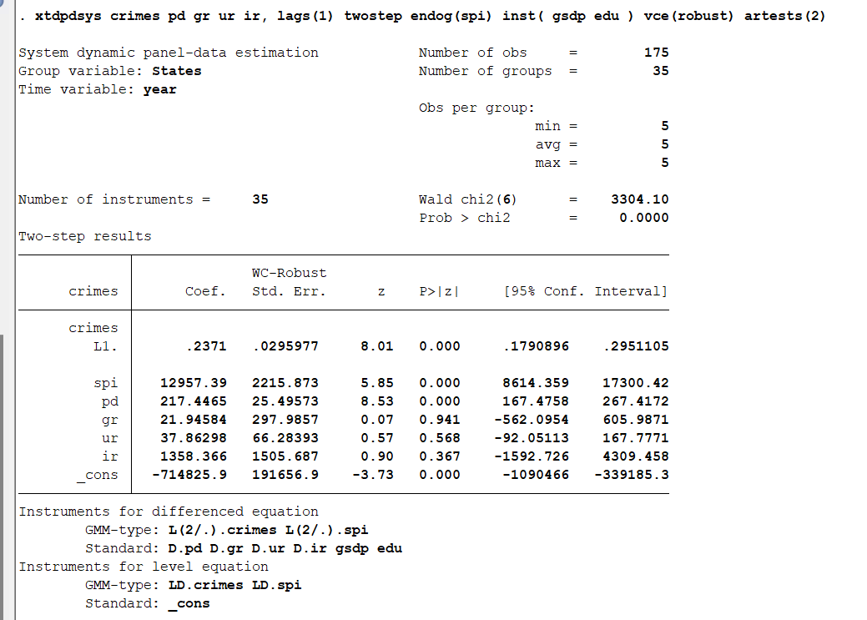
GMM ESTIMATION
ARELLANO BOVER ESTIMATION
lagged crimes variable, spiindex and population density is statistically significant. This suggests that there is a positive relationship between past crimes and current crimes

Slide 28
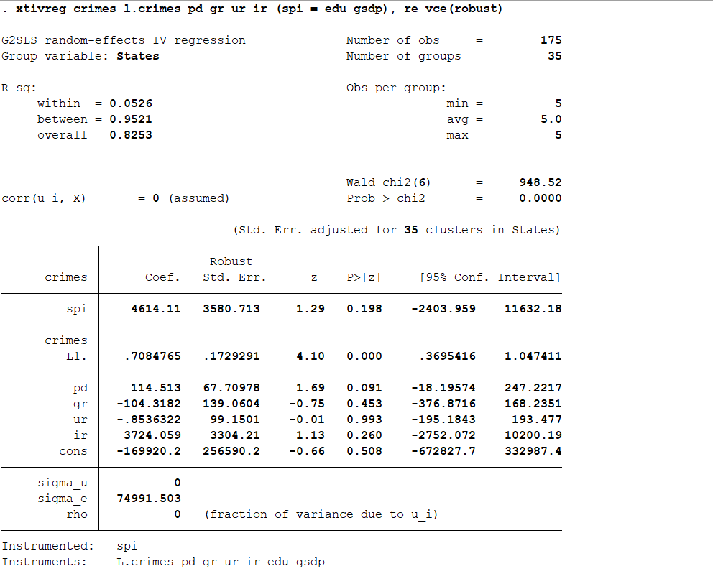
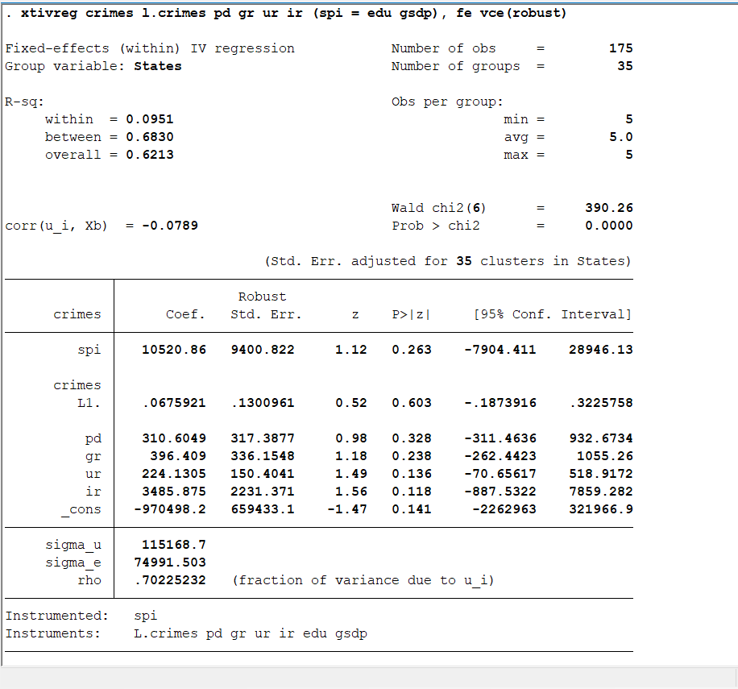
Instrumental Variable Regression(RE, FE, BE, FD)

Slide 29
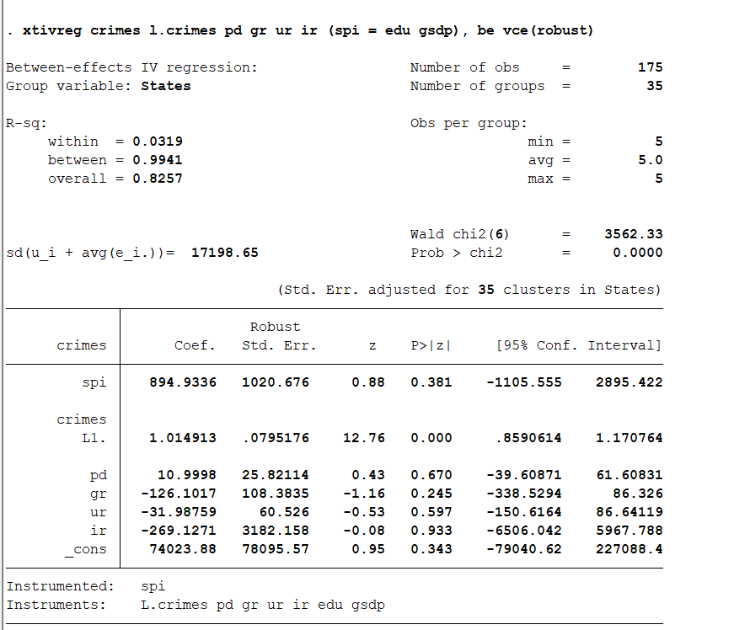
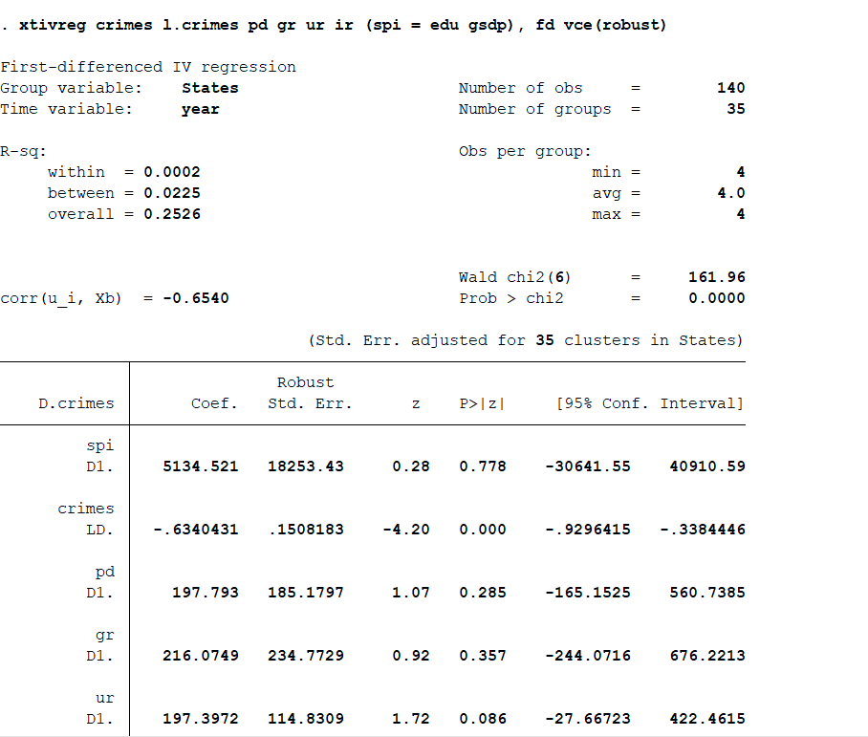
From the IV regression from different categories, it can be seen that First difference approach is the most appropriate one. Here D(l.crimes) comes significant and also D.ur comes significant at 10% significance level.

Slide 30
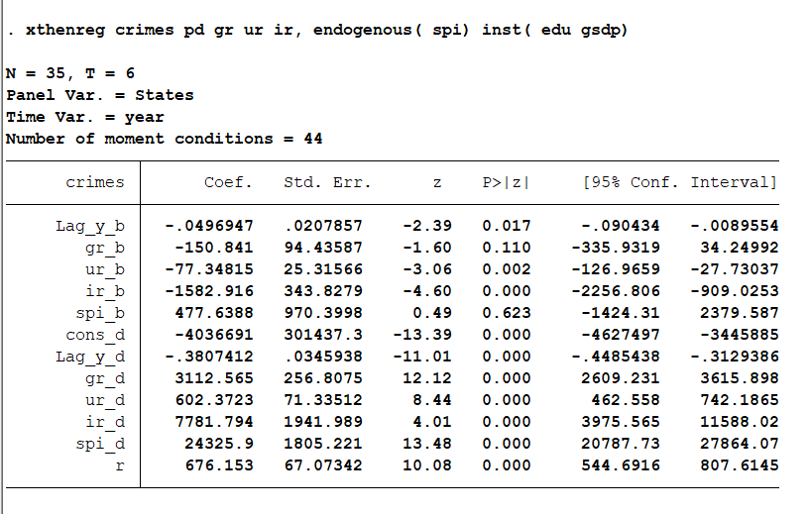
THRESHOLD REGRESSION
Here _b implies how the variable will effect crimes at low regime level(threshold level) and _d implies how variables will effect crimes at high regime levels. r is the threshold rate here. Spi, gr, ur, ir and lag of crimes has a significant effect above threshold level. But below threshold level only lag crime rates, uer and ir are significant. The significant threshold level is 676.153 here

Slide 31
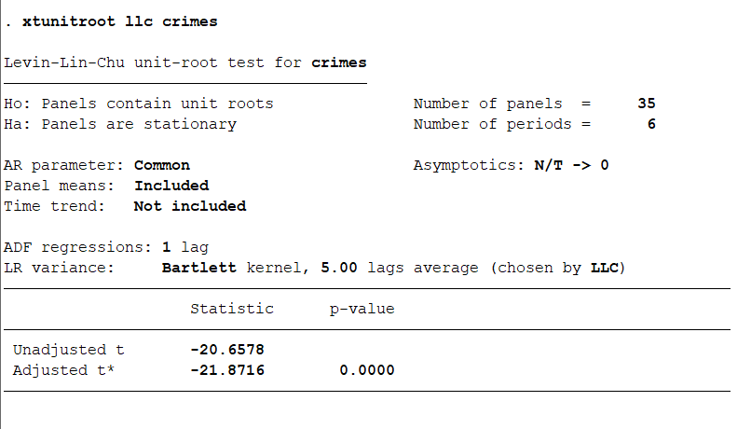
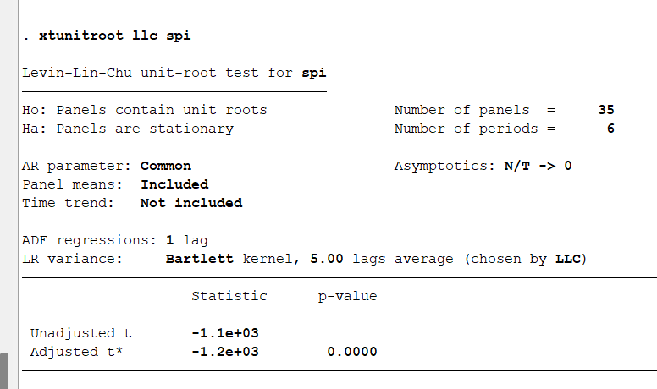
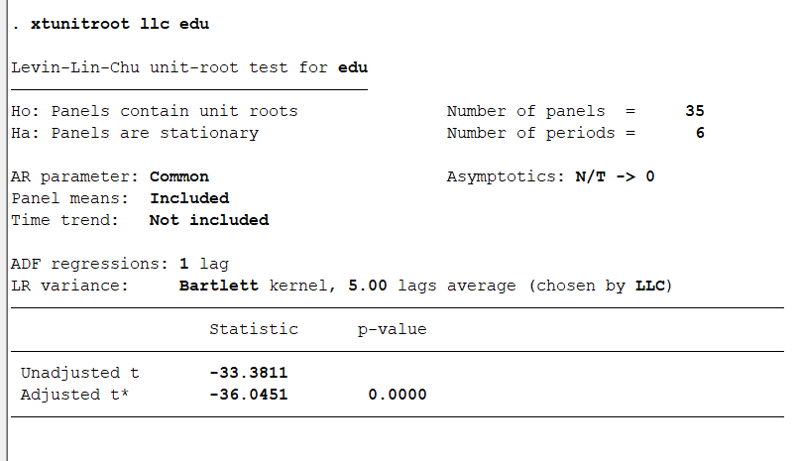
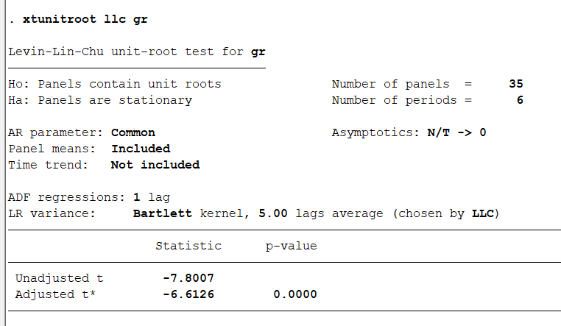
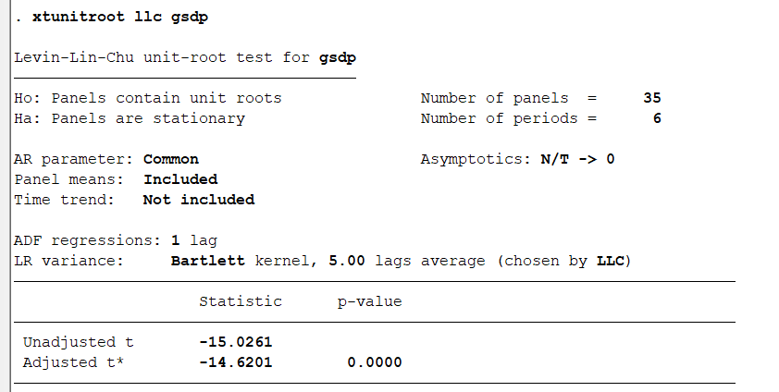
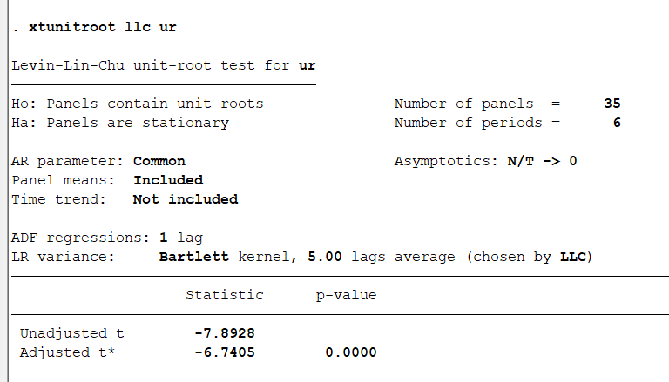
UNIT ROOTS TEST

Slide 32
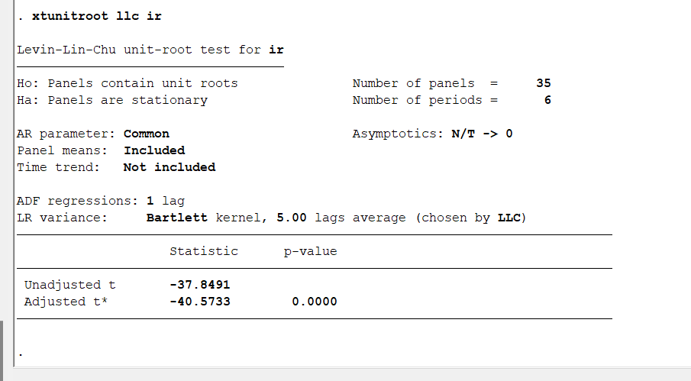
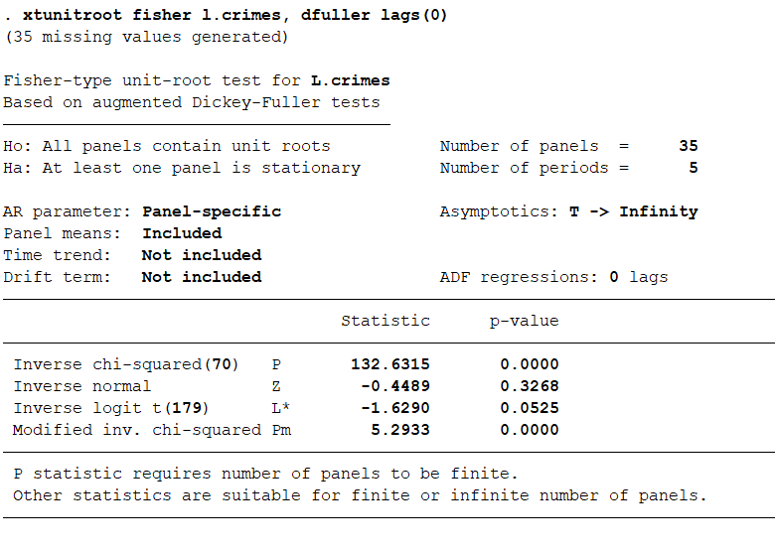
Population density is non stationary but its first difference is stationary

Slide 33
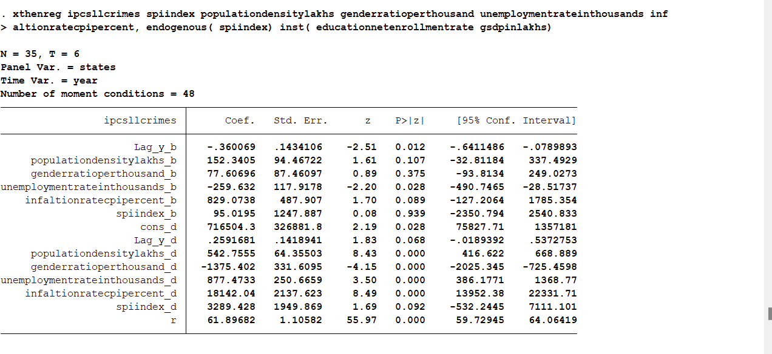

Slide 34
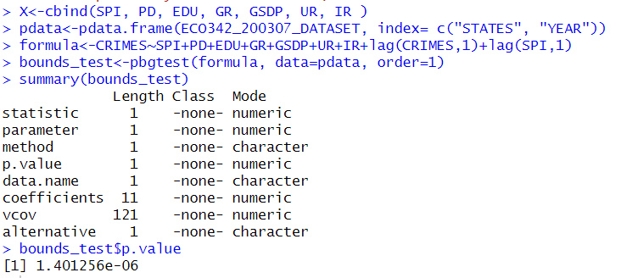
BOUNDS TEST
p-value from the bounds test is significant, it suggests evidence in favor of the presence of a long-run relationship between the variables and suggests that cointegration may be present

Slide 35
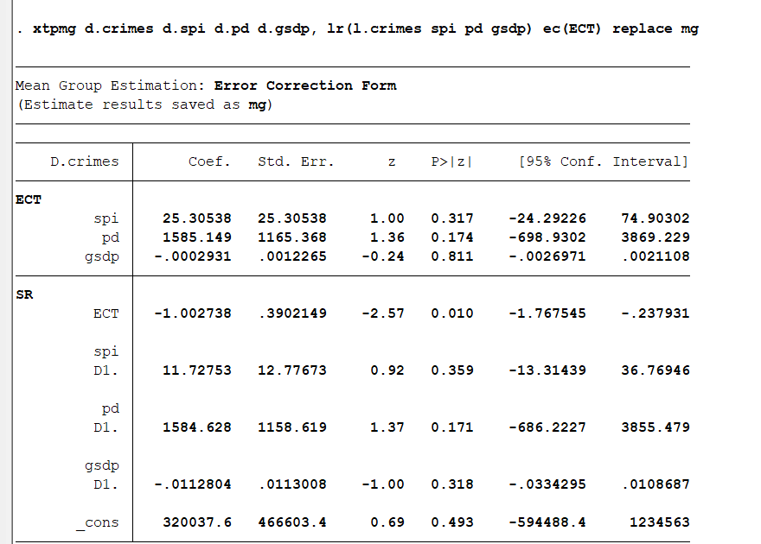
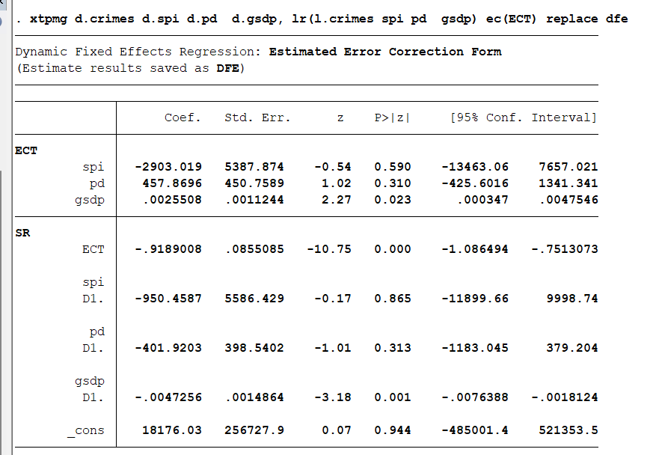
ARDL TEST
MG TEST
DFE TEST

Slide 36
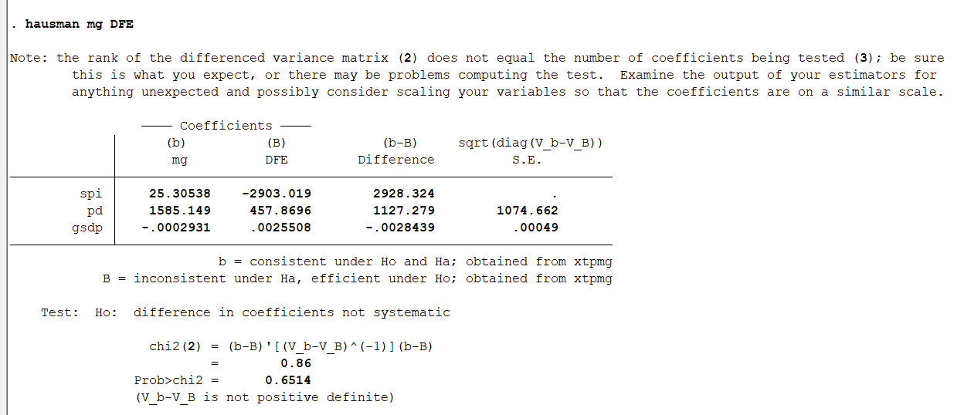
HAUSMAN TEST FOR BOTH MODELS
Mg method is consistent under Ho

Slide 37
OBJECTIVE AND SIGNIFICANCE
1.The objective of this study is to examine the connection between income inequality and crime in India using panel data analysis.
2.The study aims to determine whether income inequality has an impact on the prevalence of crime in India and to identify the ways in which it does, while considering socioeconomic and demographic factors such as age, gender, education level, and unemployment.
3.The study will use proper econometric methods GMM estimation and fixed difference regression to address the issue of endogeneity.
4.Regression models such as threshold will be used to evaluate the non-linear association between income inequality and crime
5.The study's findings could have significant policy implications for crime prevention and reduction in India

Slide 38
RESULTS OR CONCLUSIONS
Analyzing the relationship between demographics, education, unemployment, income inequality, and crime rates in India using panel dataset can provide insights into factors contributing to crime
Positive link between income inequality and crime rates in the country and population density and GDSP has a positive effect on crime rate
Addressing endogeneity issue can provide robust evidence of causal effect of income inequality on crime
Use of econometric techniques like panel VAR,GMM, ARDL cointegration threshold can identify precise nature of relationship between income inequality and crime rates
Research can provide essential insights into mechanisms through which income inequality affects crime rates in India
Can contribute to the development of policies aimed at reducing income inequality and promoting social welfare

Slide 39
VARIOUS DATASOURCES
https://www.rbi.org.in/Scripts/AnnualPublications.aspx?head=Handbook%20of%20Statistics%20on%20Indian%20States
https://dashboard.udiseplus.gov.in/#/reportDashboard/sReport
https://unemploymentinindia.cmie.com/kommon/bin/sr.php?kall=wstatmore
https://www.census2011.co.in/sexratio.php
https://ncrb.gov.in/en/crime-india
https://www.ceicdata.com/en/india/memo-items-sex-ratio-at-birth/sex-ratio-at-birth-female-per-1000-male-bihar-urban
https://www.mospi.gov.in/national-sample-survey-nss
https://www.cmie.com/kommon/bin/sr.php?kall=warticle&dt=20190624172614&msec=776
Google search

Slide 40
BASE PAPER
https://drive.google.com/drive/folders/1oAUfJlXU9UuvcEI3rwYZjd79E6jFubYH?usp=sharing
REFERENCES
https://drive.google.com/drive/folders/1MeTbzeKJs-WkytmIdj9W9DTAMiWk6HtP?usp=sharing
PLAGIARISM REPORT(SYNOPSIS)
https://drive.google.com/drive/folders/1hCy4IYCvQz74hc4OKwixmo7KyK9Lihh4?usp=sharing

Slide 41
THANK YOU

